Slide 1

Used Car Price Prediction Using Machine Learning
Presented by: Abhiram Pasaladi
Submitted to: Professor Anshuman Rangaraj

Slide 2
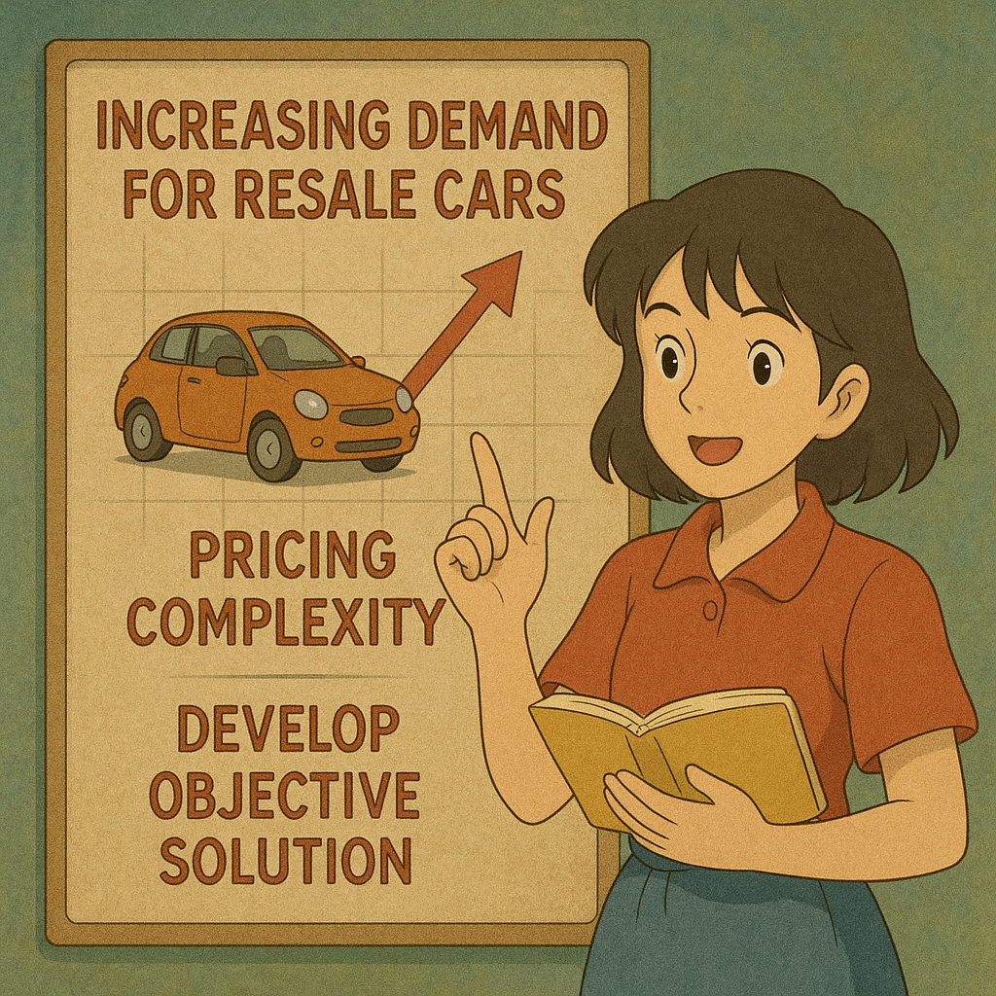
Introduction:
Demand for resale cars has increased over years due to the new cars being pricey, unaffordable and because of an individual's economic uncertainty.
Finding the correct price of a used car is difficult as it involves considering many features like odometer reading, car age, brand name, color etc...
This project explores Machine Learning models to predict the price of used cars and also provides a web app interface that can help with the accurate price prediction of resale cars.

Slide 3
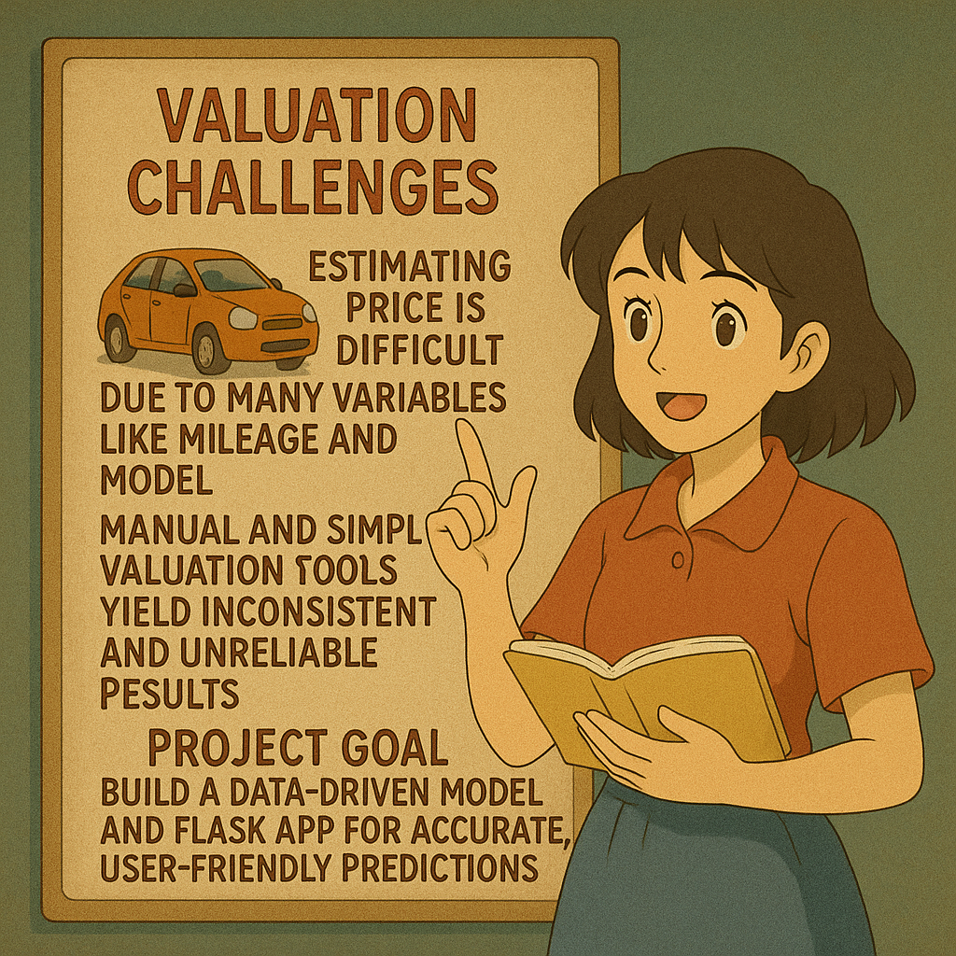
Problem Statement:
Accurately estimating used car prices is challenging due to multiple factors like mileage, condition, manufacturer, and market demand.
Manual pricing methods and third-party valuation tools often lead to inconsistent and inaccurate price estimations.
Existing machine learning models struggle with overfitting, feature selection issues, and handling large datasets covering multiple car models.
This research develops a data-driven ML model and a Flask-based web app to provide accurate and user-friendly car price predictions for buyers and sellers.

Slide 4
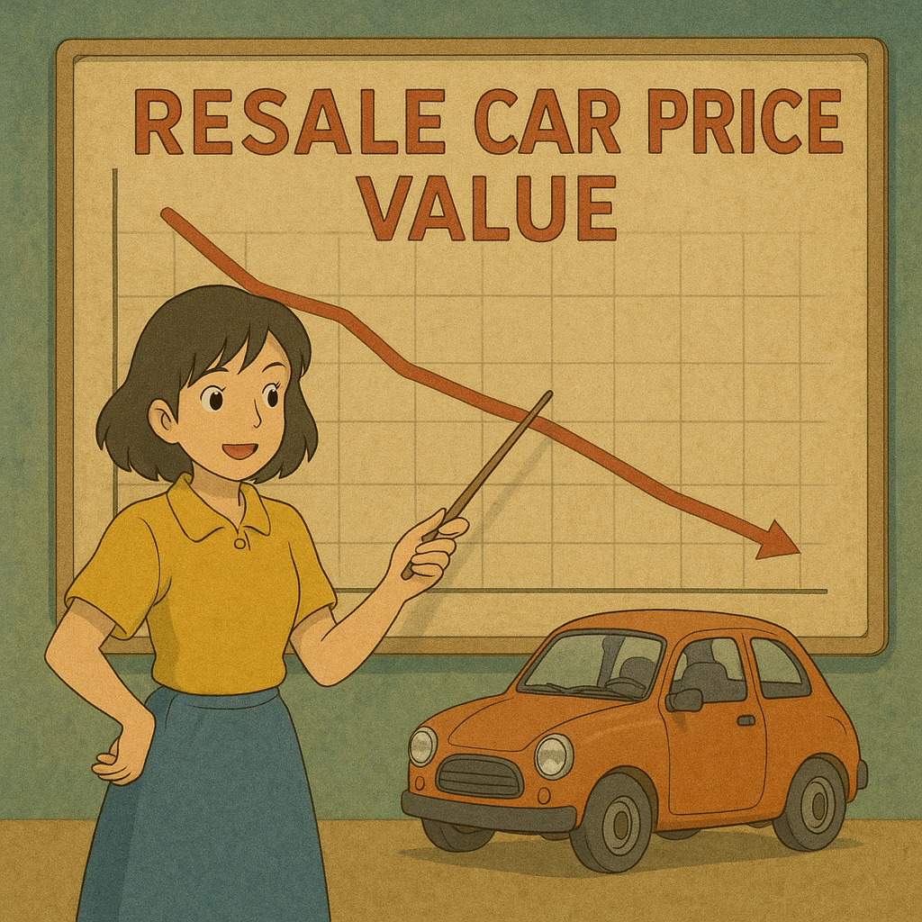
Solution Overview:
Implementation of Machine Learning models for predicting used car prices.
Consideration of various car models and features as huge dataset for the model to facilitate for many inputs consideration in Model and Web App output.
Integration of feature selection and preprocessing techniques to enhance prediction quality.
Utilization of Regression and Ensemble models for better accuracy.
Development of a Flask-based web application for easy user access.

Slide 5
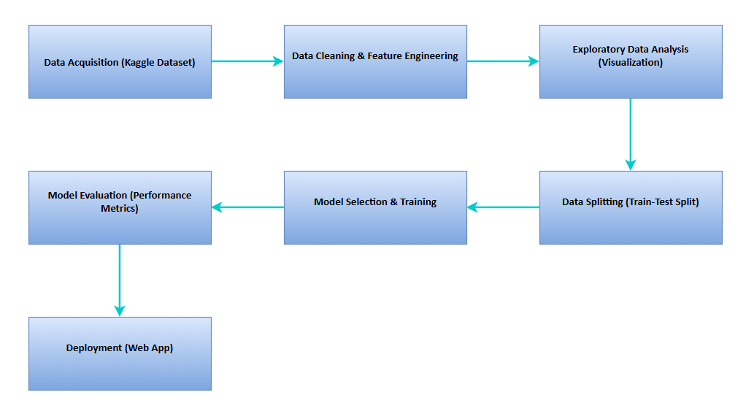
Solution Approach:

Slide 6
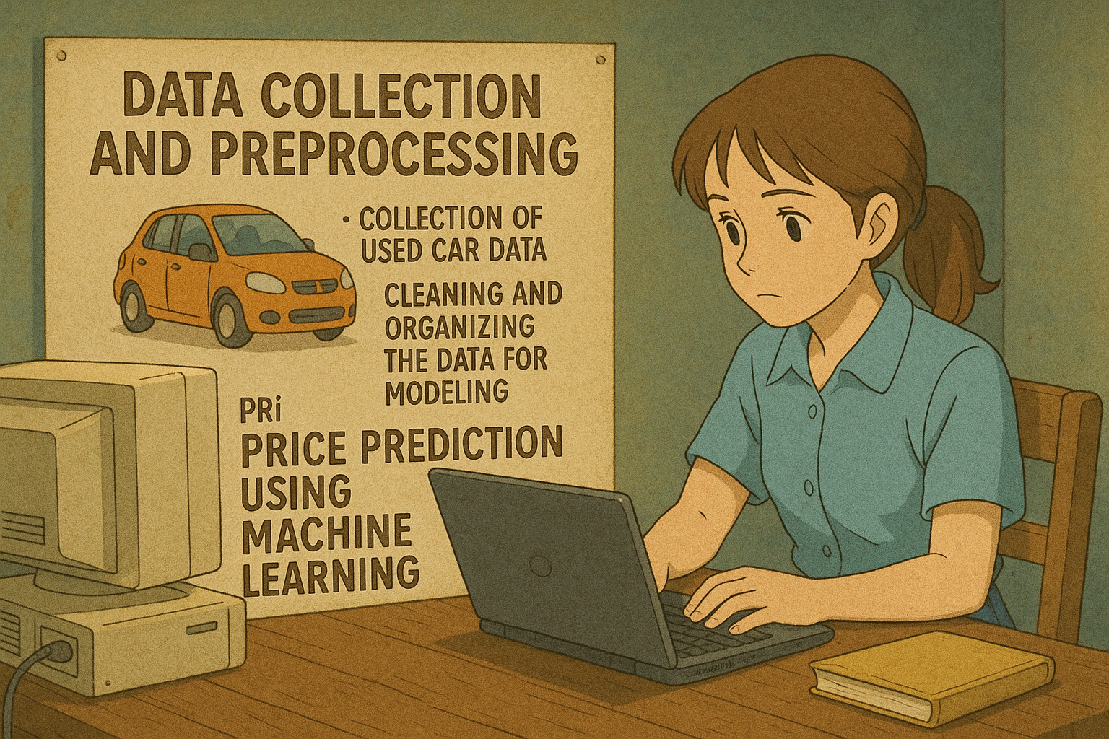
Data Collection & Preprocessing:
Dataset sourced from Kaggle: 525,839 records, 22 features (Kaggle Used Car Prices Dataset in US Dollars ).
Cleaning Steps: Removing missing values, handling outliers
Unnecessary columns like city, url, long, lat, make etc… were removed to reduce the huge dataset and improve accuracy
Incomplete and empty value rows were removed.
Outliers were also removed by considering extreme price values like removing prices under $1000 and above $100000, along with odometer readings which were exceeding 3,000,000 miles so as to make it realistic with the dataset.

Slide 7
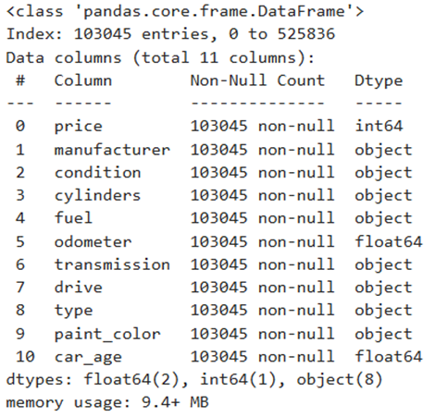
Feature Engineering: Created ‘car age’ feature and encoded categorical variables.
Finally, after data cleaning, dataset consisted of 1,03,045 rows and 11 columns with following features as shown in figure-1.
Data Split: 80% training, 20% testing to validate model performance.
Figure-1: Data Types of features in Dataset

Slide 8
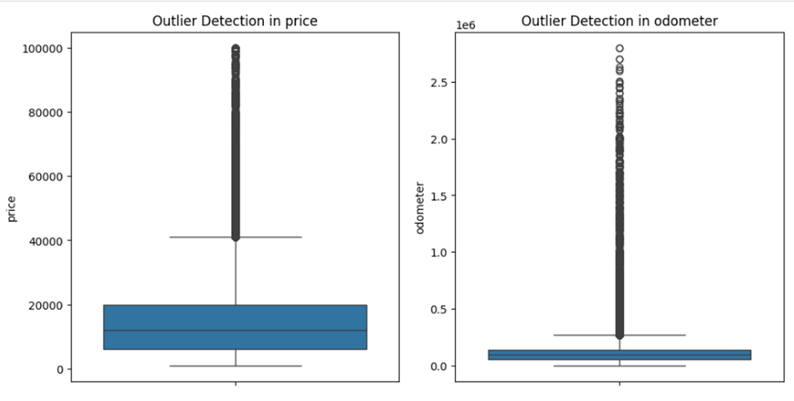
Data Visualization:
Outliers were detected and removed from price and odometer readings.

Slide 9
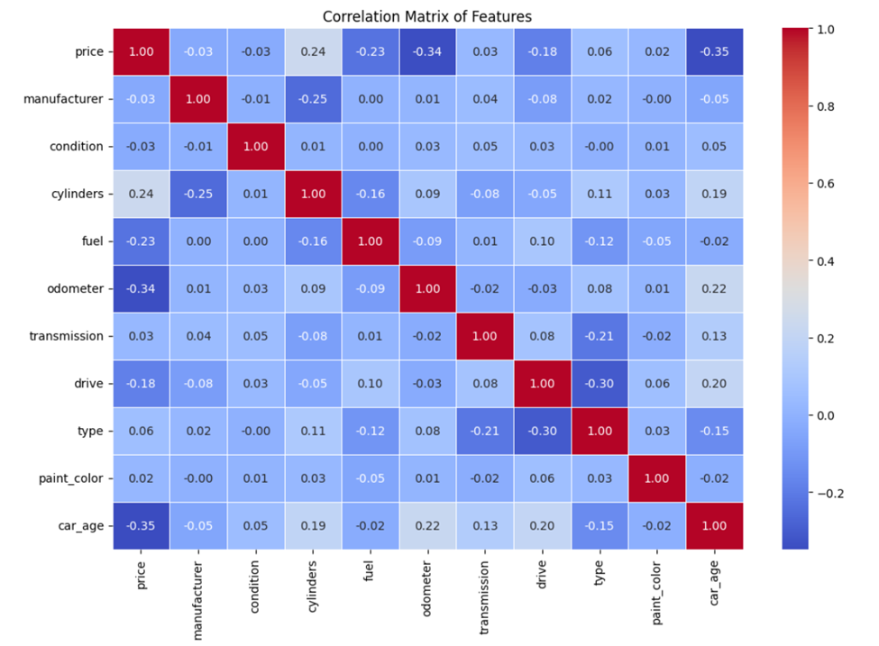
Correlation heatmap:

Slide 10
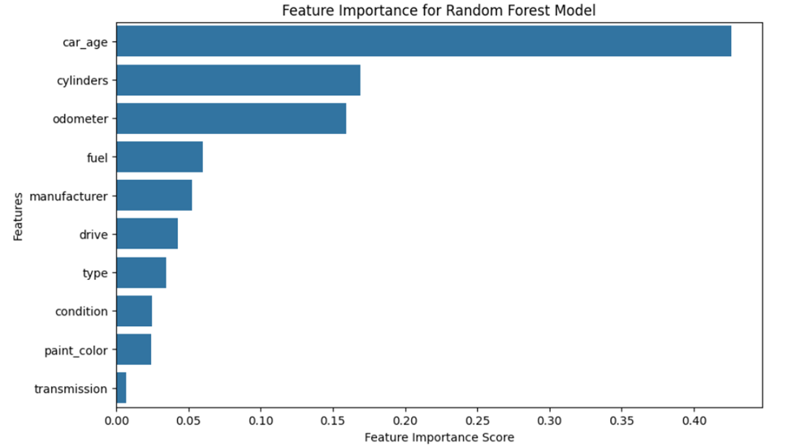
Feature Importance:

Slide 11

Machine Learning Models Used:
Regression Models: Linear Regression, Decision Tree, SVR.
Ensemble Models: Random Forest, Gradient Boosting, Stacked Regression.
Best Performing Models: Random Forest (R² = 0.82) & Stacked Regression (R² = 0.82).
Model Performance Evaluation:
Metrics Used:
Mean Absolute Error (MAE)
Mean Squared Error (MSE)
Root Mean Squared Error (RMSE)
R² Score
Random Forest and Stacked Regression models provided the best accuracy.

Slide 12

Web Application for Car Price Prediction:
Web app for car price prediction made using Python and Flask.
Takes user input for all 11 features used in modelling like manufacturer, condition, mileage, cylinders, fuel, transmission, drive, type, paint color, odometer and year.
The model predicts a resale price based on trained Machine Learning model using Random Forest model.
User-friendly interface for easy access and predictions.

Slide 13
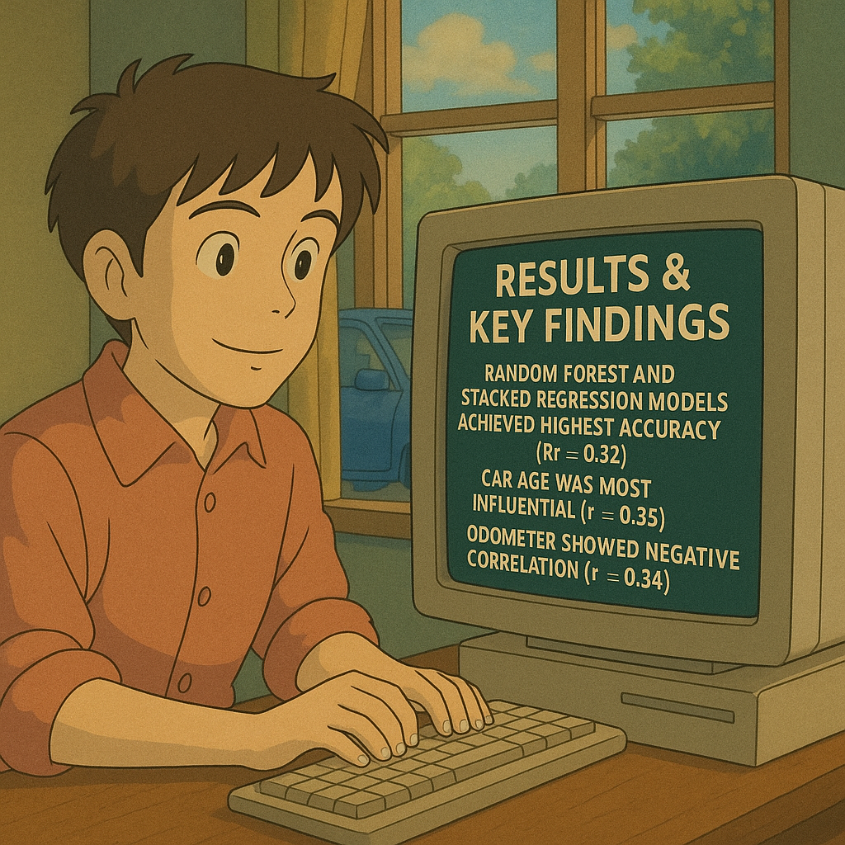
Results & Key Findings:
Random Forest and Stacked Regression models achieved the highest accuracy (R² = 0.82) in predicting used car prices.
Car age was the most influential feature, showing a negative correlation (-0.35) with price, confirming that older cars sell for lower prices.
Cylinders surprisingly ranked as the second most important feature, with a positive correlation (0.24) with price, indicating that luxury/performance cars have higher resale values.
Odometer readings had a negative correlation (-0.34) with price, but its impact was slightly reduced due to collinearity with car age.
Fuel type (-0.23), drive type (-0.18), and manufacturer/paint color had minimal impact on price predictions, showing limited predictive power.

Slide 14
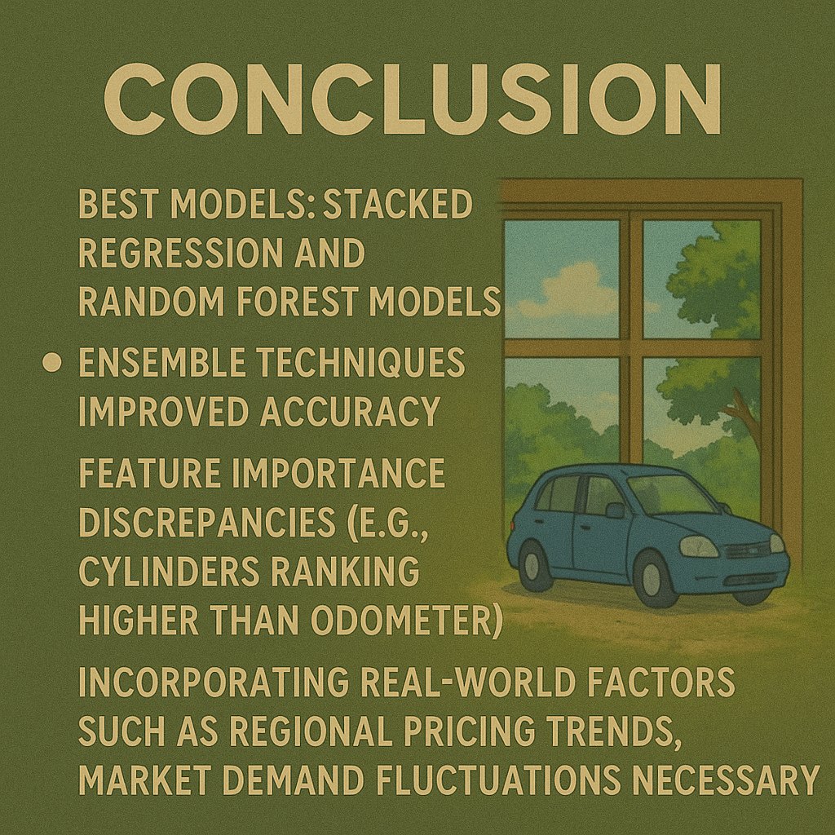
Conclusion:
Stacked Regression and Random Forest models effectively predicted used car prices by handling non-linear relationships and large datasets.
Ensemble techniques improved accuracy by mitigating overfitting and enhancing generalization across unseen data.
Feature importance discrepancies (e.g., cylinders ranking higher than odometer) highlight the need for advanced feature selection methods like Permutation Importance.
Incorporating real-world factors such as regional pricing trends, market demand fluctuations, and vehicle service history can further enhance model accuracy and reliability.

Slide 15


